Slide 1

BANK CRM
CUSTOMER RELATIONSHIP
MANAGEMENT
Presented by: Kajal

Slide 2



Introduction
This project explores the intricate issue of customer churn within the banking sector, aiming to understand the factors influencing customer attrition and develop effective retention strategies. By utilizing SQL, we thoroughly analyze customer demographics, account details, and transactional behaviors to uncover insights that contribute to churn.
Through this investigation, we seek to provide businesses with practical recommendations to boost customer loyalty and achieve sustainable growth in the competitive banking sector.

Slide 3
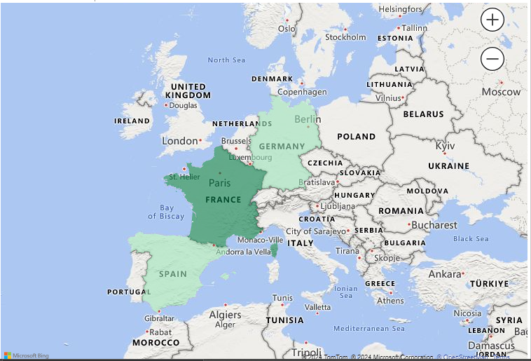
Data Overview
01
The dataset used for this analysis consists of customer information from a bank, aimed at understanding and predicting customer churn. The dataset includes 10,000 records with various attributes such as customer demographics, account details, and product usage.
02
The key variables in the dataset include CustomerID, Surname, CreditScore, Geography, Gender, Age, Tenure, Balance, NumOfProducts, HasCrCard, IsActiveMember, EstimatedSalary, and Exited. These variables provide a comprehensive view of each customer, allowing for detailed analysis of factors contributing to churn.
03
The data was thoroughly cleaned and prepared before analysis. No missing values were found, ensuring completeness. Categorical variables were encoded into numerical values, and significant outliers were identified and managed to enhance analysis accuracy. The data was sourced from the bank’s internal customer records, specifically focusing on details pertinent to churn analysis.

Slide 4

Methodology
Data Preprocessing
Exploratory Data Analysis (EDA)
Data underwent rigorous cleaning and preprocessing to handle missing values, encode categorical variables, and normalize numerical features. Outliers were addressed to ensure data integrity and accuracy.
EDA techniques were employed to gain insights into customer demographics, account balances, product usage, and churn rates. Visualizations aided in identifying patterns and trends crucial for subsequent analysis.
SQL Queries
Dashboard Creation
SQL queries were utilized to segment customers based on demographics and account details, such as balance ranges, age groups, and product usage. These segments provided valuable insights for targeted marketing strategies.
A comprehensive dashboard was designed to visualize key performance indicators (KPIs) and metrics, with interactive slicers enabling dynamic data filtering by gender, year, and age for deeper insights into customer churn and retention strategies.

Slide 5

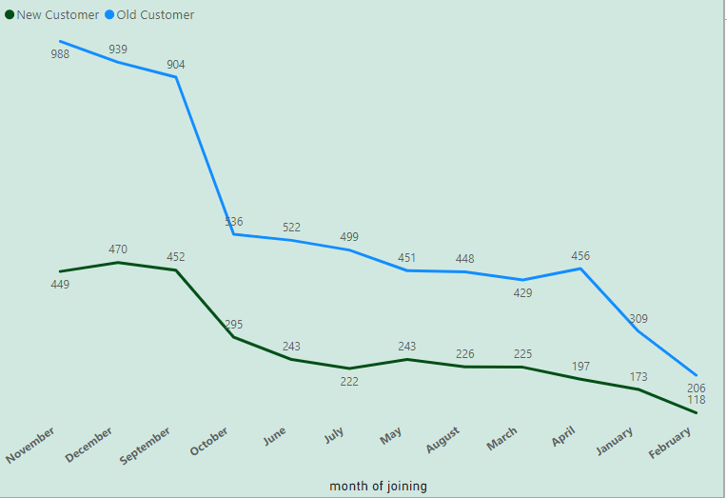
Account Balance Distribution Across Regions
Analyzed distribution of account balances among regions (France, Spain, Germany) using SQL.
Provided insights into total, average, maximum, and minimum balances for each region.
Objective Analysis
Top 5 Customers with Highest Estimated Salary
Identified top 5 customers with highest estimated salaries in last quarter using SQL.
Retrieved CustomerID, Surname, and EstimatedSalary from customerinfo table.
Average Number of Products for Customers with Credit Cards
Calculated average number of products used by customers with credit cards using SQL.
Retrieved NumOfProducts from churn table for customers with credit cards.
Churn Rate by Gender for Most Recent Year
Assessed churn rate by gender for most recent year in dataset using SQL.
Computed churn rate for each gender and filtered data for latest year.
Comparison of Average Credit Score for Exited and Retained Customers
Conducted comparison of average credit scores between exited and retained customers.
Calculated average credit score for each group and analyzed results.

Slide 6
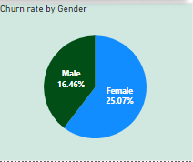
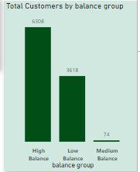
Subjective Analysis
Discover key factors driving customer loyalty and retention. Explore predictive indicators, regional dynamics, and targeted strategies. Uncover correlations between product engagement, geographic influences, and customer lifetime value. Gain insights into income, credit score, and account balance dynamics. Craft personalized retention strategies based on age and tenure patterns.
Predictive Factors for Churn
Product Engagement and Retention
Regional Dynamics and Strategy Formulation
Account balance, estimated salary, and credit score are pivotal variables in forecasting customer churn, providing essential insights into potential indicators of attrition
Active engagement with multiple bank products is associated with reduced churn rates, highlighting the importance of cross-selling initiatives in fortifying customer loyalty
Regional variations in customer behavior and account balances necessitate tailored strategies to address distinct market dynamics and cater to diverse customer needs effectively
Unlocking Customer Lifetime Value
Decoupling Income from Account Balance
Age, Tenure, and Retention Strategies
Analysis of average tenure and account balances offers valuable insights into customer lifetime value, empowering businesses to devise targeted retention strategies for maximum profitability
Limited correlation between income and account balance suggests that factors beyond income significantly influence balance, such as spending habits and financial priorities
Analysis of age and tenure patterns reveals nuanced insights, guiding the development of personalized retention strategies to address the diverse needs of different customer segments

Slide 7
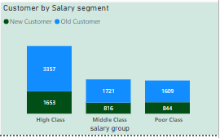

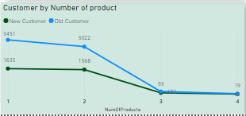
Customer Segmentation Analysis
Balance Distribution: Majority of customers in "Very Low" and "Medium" balance categories.
Age Distribution: Significant number of "Adult" customers across all balance ranges.
Insights:
Very Low Balance: Largest customer segment, indicating predominance of low account balances.
Medium Balance: Second-largest segment, representing a financially stable group.
High Balance: Moderate number of customers, showing potential for growth.
Very High Balance: Exclusive segment with few customers, signifying high net-worth individuals.
Conclusion: Understanding customer segments based on balance and age helps tailor marketing strategies and financial products for diverse needs.

Slide 8

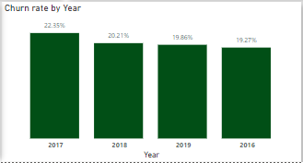
Churn Rate Analysis
Recommendations to Reduce Churn
Customer Segments Prone to Churn
Churn Rate
Targeted Product Bundles: Customize bundles to meet individual needs, particularly for single-product users, highlighting added benefits and cost savings.
Enhanced Credit Card Rewards: Adjust credit limits based on customer history, align rewards with spending habits (e.g., travel, cash back), and consider fee reductions for loyal customers.
Retention Offers for Existing Customers: Provide personalized retention deals, such as extended introductory rates or discounts on additional products/services, to customers approaching the end of their offers.
Customer Satisfaction Surveys: Conduct regular surveys to pinpoint reasons for churn, allowing for tailored retention strategies and continuous improvement.
Single Product Users: Customers who only use one product might not perceive sufficient value compared to competitors offering a broader range of services.
Credit Card Holders: Possible reasons for churn include insufficient credit limits, lack of appealing rewards programs, and high fees.
Tenure of 4-5 Years: Customers with this tenure might be losing introductory offers or discounts, making them more susceptible to better offers from competitors.
High Salary Earners: These customers may have more options and might switch for slightly better rates or benefits.
Overall Churn Rate: 20.37%
Year-on-Year Churn Rates:
2016: 19.27% (lowest)
2017: 22.35% (highest)
2018: 20.21%
2019: 19.86%

Slide 9





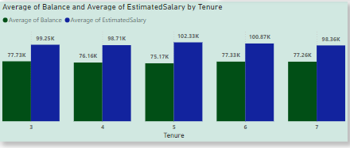
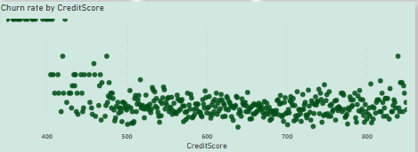
Key Insights
There insights offer valuable guidance for strategic decision-making and customer-centric approaches to enhance retention, reduce churn, and maximize profitability.
Majority of customers fall into "Very Low" and "Medium" balance categories.
Significant representation of "Adult" and "Old" age groups across all balance ranges.
Insights suggest a need for tailored strategies based on age and balance segments.
Overall churn rate is 20.37%, with fluctuations observed across years.
Customers with "Poor" credit scores and those with shorter tenure are more likely to churn.
Targeted strategies such as product bundles and enhanced credit card rewards can help mitigate churn.
Customers with lower salaries and fair to poor credit scores pose higher financial risks.
Tailored retention strategies and financial education programs can help mitigate risks associated with these segments.
Customers with medium balances and high salaries exhibit the highest average tenure.
Tailored services and perks are essential to maintain loyalty among this segment and enhance overall customer lifetime value.
Effectiveness of marketing campaigns varies across channels and demographics.
Targeted campaigns based on customer segments and preferences can improve retention and acquisition rates.
Customer Segmentation Analysis
Risk Management Assessment
Customer Tenure Value Forecast
Marketing Campaign Effectiveness
Churn Rate Analysis

Slide 10
Conclusion
The comprehensive analysis of customer behavior, segmentation, churn rates, and marketing effectiveness provides valuable insights for strategic decision-making within the bank. Here are the key takeaways:
Customer-Centric Strategies: Tailoring products, services, and marketing campaigns to specific customer segments is essential for enhancing satisfaction, retention, and overall profitability.
Churn Mitigation: Understanding the factors contributing to churn, such as credit scores, tenure, and product usage, enables the development of targeted retention strategies to reduce churn rates and improve customer loyalty.
Risk Management: Identifying high-risk customer segments, such as those with lower salaries and credit scores, allows for proactive measures to mitigate financial risks and enhance stability.
Long-Term Value Creation: By focusing on customer lifetime value and fostering long-term relationships through personalized services, the bank can maximize profitability and sustainable growth.
In conclusion, the insights gained from this analysis serve as a foundation for implementing customer-centric initiatives, enhancing risk management practices, and optimizing marketing strategies to drive success in the highly competitive banking industry.

Slide 11
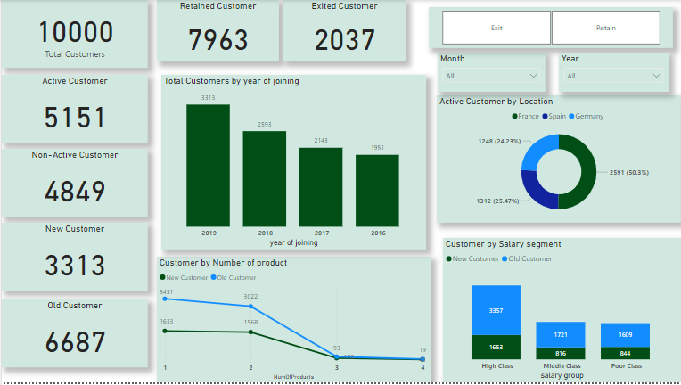
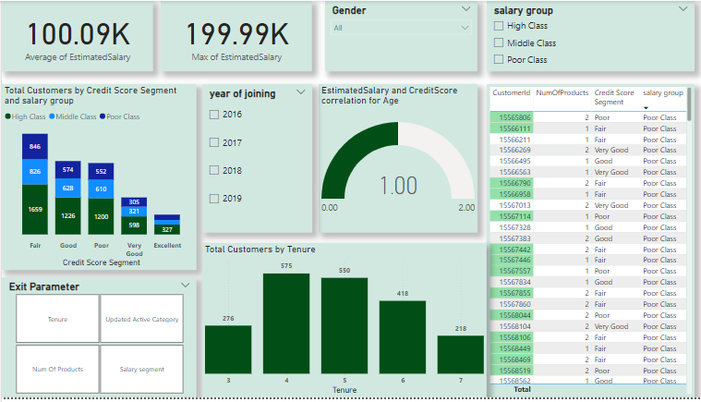
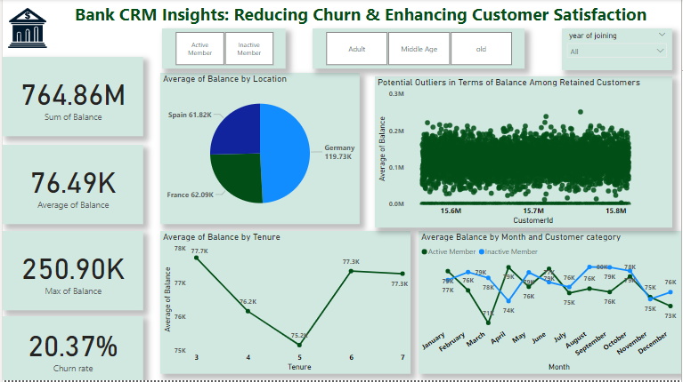
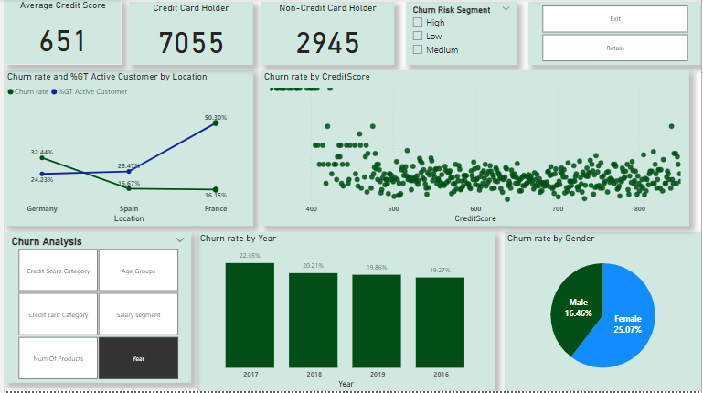
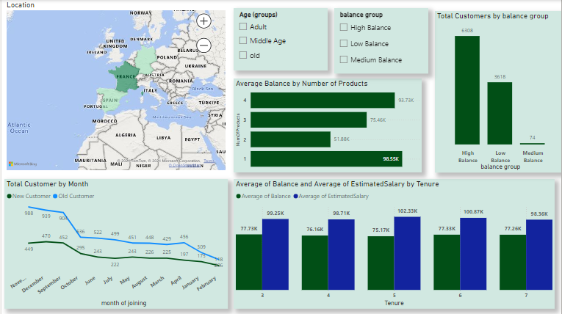
DashBoard
Balance
Salary
Customer
Churn rate
Additional analysis

Slide 12


